Slide 1
Real-time scheduling algorithms:
In a simple real-time system, there might be no need for a scheduler, one task can simply call the next.
But for more complex real-time systems, that have a large but fixed number of tasks that do not function in pipeline function, one may need static scheduling.
Static Scheduling is the mechanism, where we have already controlled the order/way that the threads/processes are executing in our code (Compile time).
And for real-time systems where the workload keeps changing, one may need dynamic scheduling.
Dynamic Scheduling is the mechanism where thread scheduling is done by the operating systems based on any scheduling algorithm implemented in OS level

Slide 2
In dynamic scheduling two important question arises:
1.How to handle the overload?
To handle the overload these processes can be used:
Best efforts
Work shedding
2.How to choose which process to execute first?
To decide which process to execute first from the ready queue these methods may be used:
SJF
Static priority
Slack time.

Slide 3
Thread scheduling
Scheduling of threads involves two boundary scheduling,
Scheduling of user level threads (ULT) to kernel level threads (KLT) via lightweight process (LWP) by the application developer.
Scheduling of kernel level threads by the system scheduler to perform different unique OS functions.

Slide 4
Light weight Process (LWP) :
Light-weight process are threads in the user space that acts as an interface for the ULT(user level threads) to access the physical CPU resources.
Thread library schedules which thread of a process to run on which LWP and how long.
The number of LWP created by the thread library depends on the type of application.
In the case of an I/O bound application, the number of LWP depends on the number of user-level threads.
This is because when an LWP is blocked on an I/O operation, then to invoke the other ULT the thread library needs to create and schedule another LWP.
Thus, in an I/O bound application, the number of LWP is equal to the number of the ULT. In the case of a CPU bound application, it depends only on the application.
Each LWP is attached to a separate kernel-level thread.

Slide 5
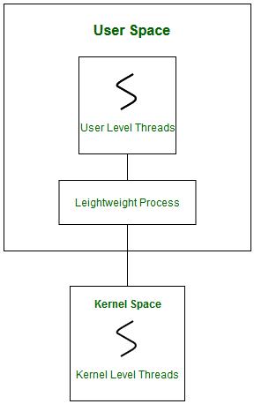

Slide 6
In real-time, the first boundary of thread scheduling is beyond specifying the scheduling policy and the priority.
It requires two controls to be specified for the User level threads: Contention scope, and Allocation domain.
These are explained as following below.

Slide 7
1. Contention Scope :
The word contention here refers to the competition or fight among the User level threads to access the kernel resources.
Thus, this control defines the extent to which contention takes place.
It is defined by the application developer using the thread library.
Depending upon the extent of contention it is classified as Process Contention Scope and System Contention Scope.

Slide 8
Process Contention Scope (PCS) –
The contention takes place among threads within a same process.
The thread library schedules the high-prioritized PCS thread to access the resources via available LWPs (priority as specified by the application developer during thread creation).
System Contention Scope (SCS) –
The contention takes place among all threads in the system.
In this case, every SCS thread is associated to each LWP by the thread library and are scheduled by the system scheduler to access the kernel resources.
In LINUX and UNIX operating systems, the POSIX Pthread library provides a function Pthread_attr_setscope to define the type of contention scope for a thread during its creation. (POSIX (Portable Operating System Interface) is a set of standard operating system interfaces based on the Unix operating system.)

Slide 9

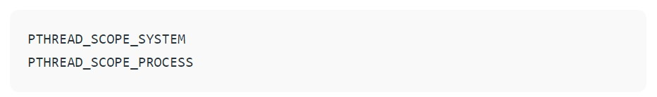
The first parameter denotes to which thread within the process the scope is defined. The second parameter defines the scope of contention for the thread pointed. It takes two values.
If the scope value specified is not supported by the system, then the function returns ENOTSUP (Operation not supported (POSIX.1-2001)).

Slide 10
2. Allocation Domain :
The allocation domain is a set of one or more resources for which a thread is competing.
In a multicore system, there may be one or more allocation domains where each consists of one or more cores.
One ULT can be a part of one or more allocation domain.
Due to this high complexity in dealing with hardware and software architectural interfaces, this control is not specified.
But by default, the multicore system will have an interface that affects the allocation domain of a thread.

Slide 11
Consider a scenario, an operating system with three process P1, P2, P3 and 10 user level threads (T1 to T10) with a single allocation domain.
100% of CPU resources will be distributed among all the three processes.
The amount of CPU resources allocated to each process and to each thread depends on the contention scope, scheduling policy and priority of each thread defined by the application developer using thread library and also depends on the system scheduler.
These User level threads are of a different contention scope.

Slide 12
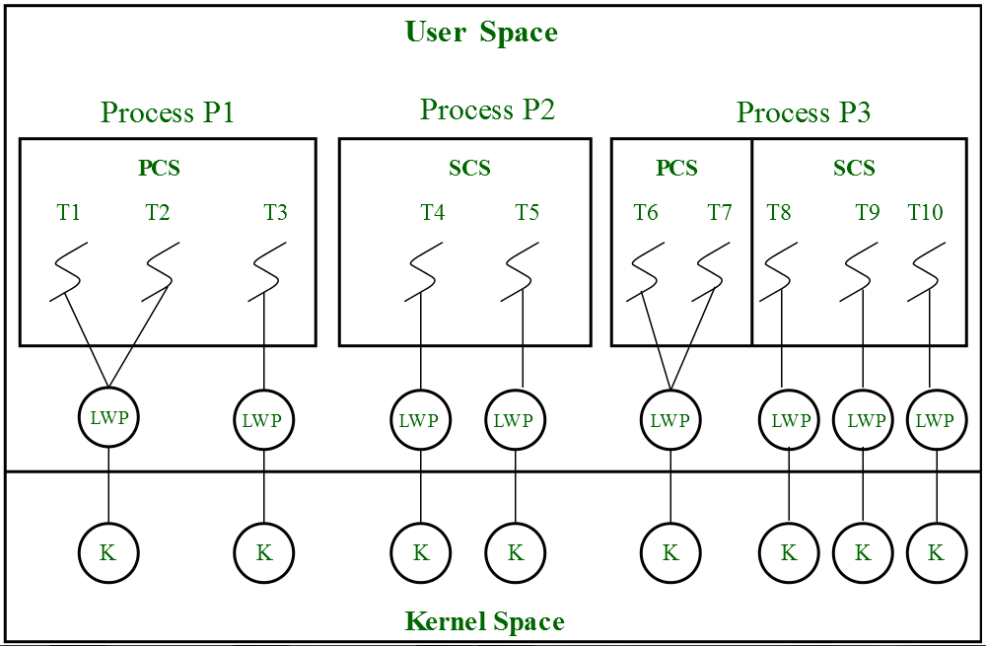
In this case, the contention for allocation domain takes place as follows,

Slide 13
1.Process P1:
All PCS threads T1, T2, T3 of Process P1 will compete among themselves. The PCS threads of the same process can share one or more LWP.
T1 and T2 share an LWP and T3 are allocated to a separate LWP.
Between T1 and T2 allocation of kernel resources via LWP is based on preemptive priority scheduling by the thread library.
A Thread with a high priority will preempt low priority threads.
Whereas, thread T1 of process P1 cannot preempt thread T3 of process P3 even if the priority of T1 is greater than the priority of T3.
If the priority is equal, then the allocation of ULT to available LWPs is based on the scheduling policy of threads by the system scheduler (not by thread library, in this case).

Slide 14
2.Process P2:
Both SCS threads T4 and T5 of process P2 will compete with processes P1 as a whole and with SCS threads T8, T9, T10 of process P3.
The system scheduler will schedule the kernel resources among P1, T4, T5, T8, T9, T10, and PCS threads (T6, T7) of process P3 considering each as a separate process.
Here, the Thread library has no control of scheduling the ULT to the kernel resources.

Slide 15
3.Process P3:
Combination of PCS and SCS threads.
Consider if the system scheduler allocates 50% of CPU resources to process P3, then 25% of resources is for process scoped threads and the remaining 25% for system scoped threads.
The PCS threads T6 and T7 will be allocated to access the 25% resources based on the priority by the thread library.
The SCS threads T8, T9, T10 will divide the 25% resources among themselves and access the kernel resources via separate LWP and KLT.
The SCS scheduling is by the system scheduler.

